Slide 1


D MART DATA ANALYSIS USING POWER BI

Slide 2

TEAM NAME :
FANTASTIC 5
GROUP MEMBERS :
1. RUPA SRI VARSINI
2.VIJI
3.AMARNATH
4.SUBHALAKSHMI
5.THEO SAVIO

Slide 3

Introduction and Objectives
Purpose:
The project aims to analyze D-Mart's sales, customer behavior, and inventory data to derive actionable insights and improve operational efficiency.
Objectives:
Gain insights into sales trends and customer purchasing patterns.
Identify inventory gaps and optimize stock levels.
Utilize Power BI to create dynamic dashboards for effective decision-making.

Slide 4

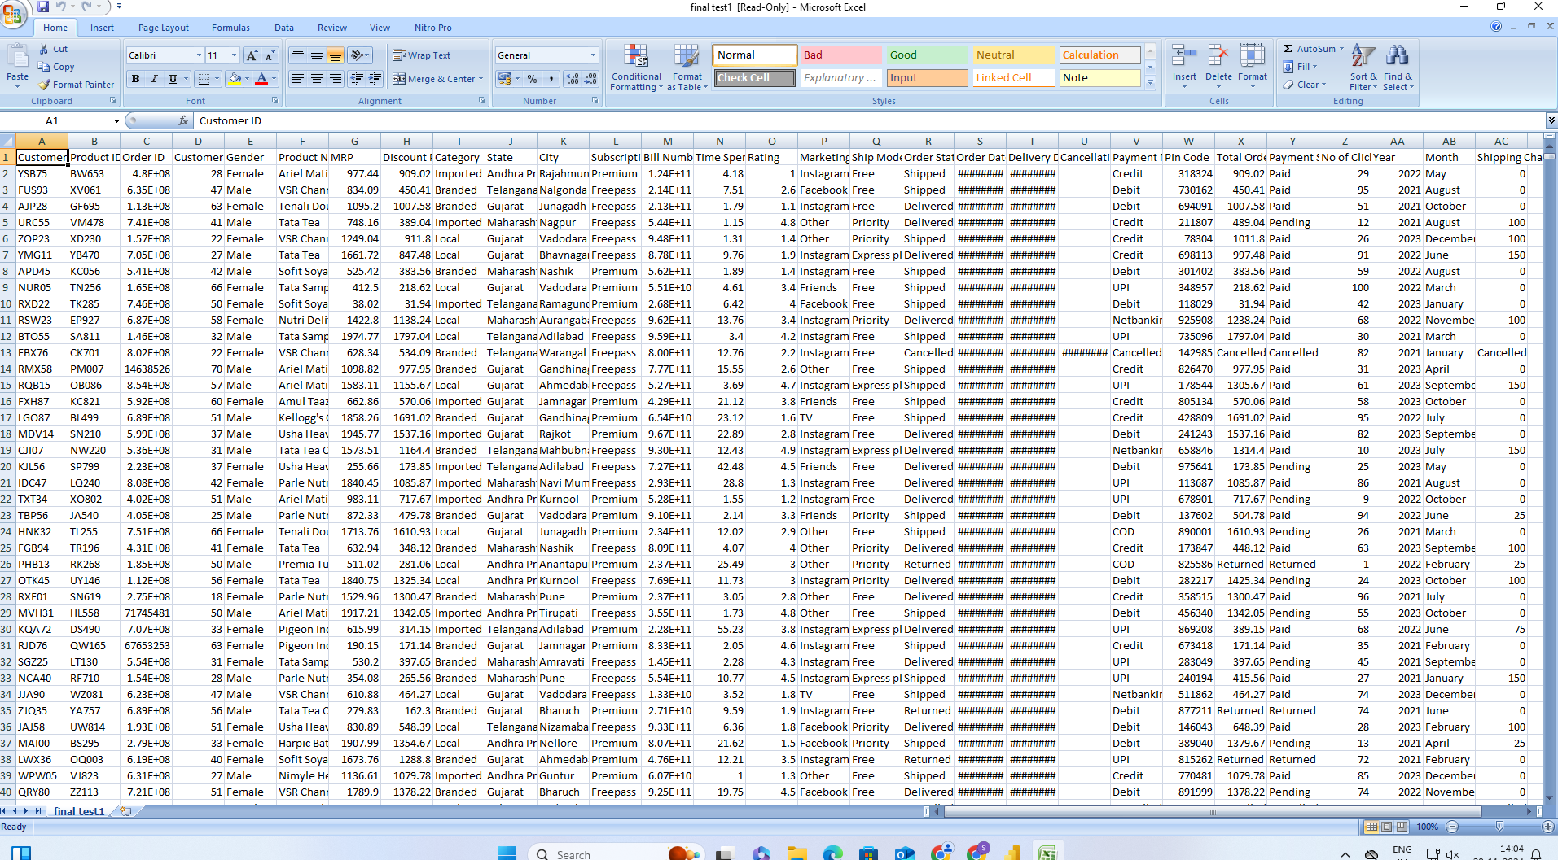
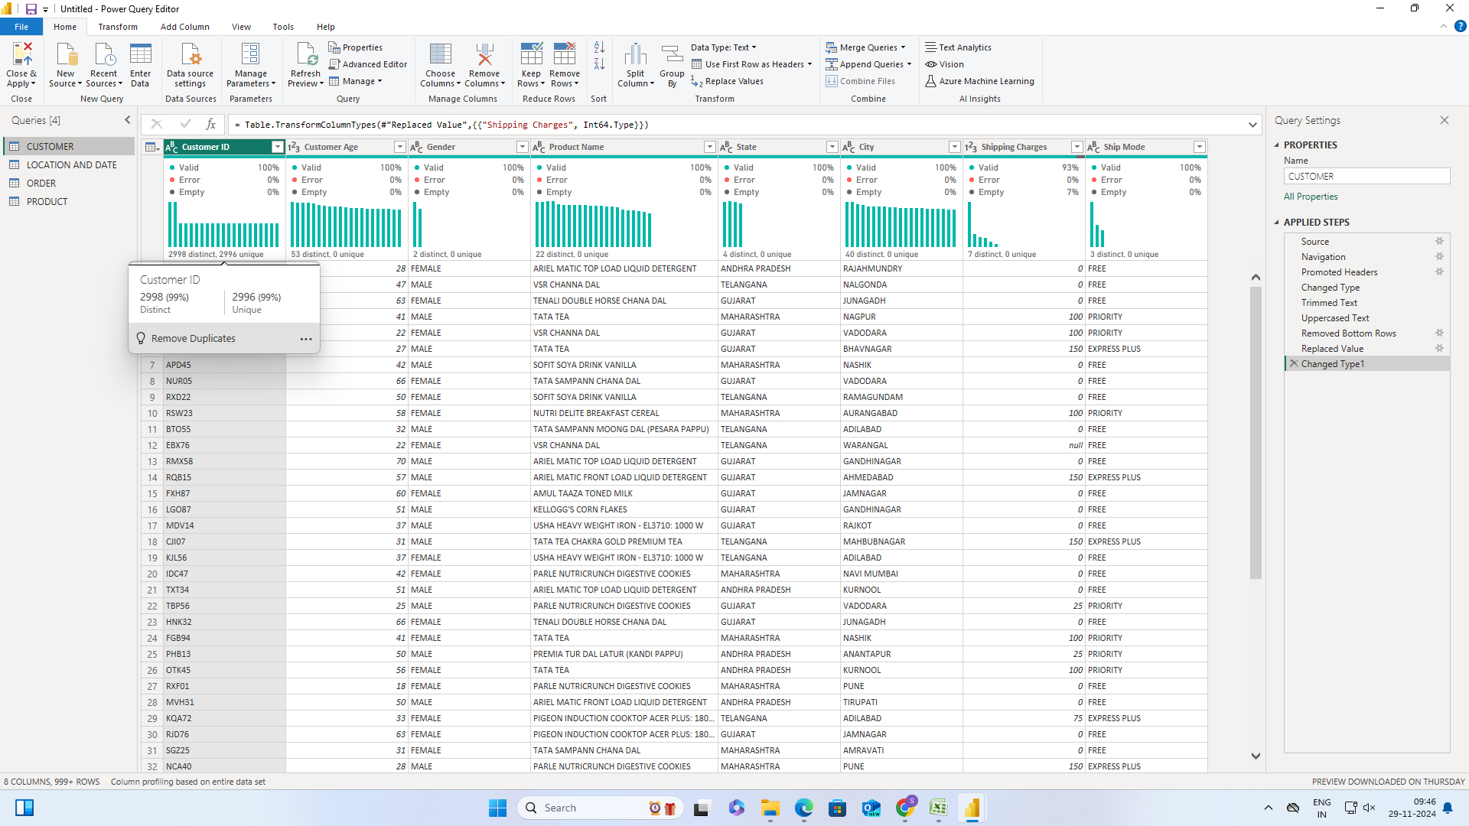
Data collection and preparation
Data Sources:
Sales transaction data, customer feedback surveys, and inventory reports.
Exported data in CSV and Excel formats from D-Mart’s database.
Data Preparation:
Cleaned and transformed data to ensure consistency.
Removed duplicates, handled missing values, and standardized formats.
Imported data into Power BI for integration and analysis.

Slide 5
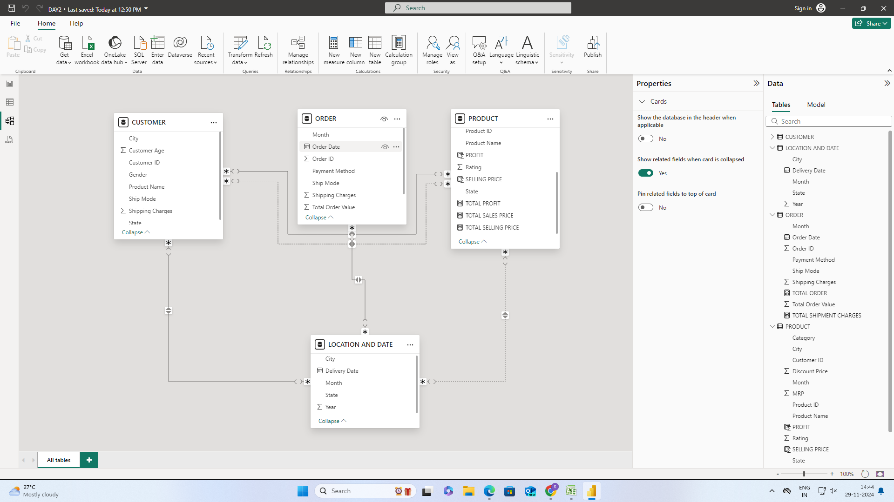
Data Modelling in Power Bi
Designed relationships between order, customer, location and product tables.
Established one-to-many relationships for seamless data flow.
Ensured proper key constraints for accurate aggregation and filtering.

Slide 6
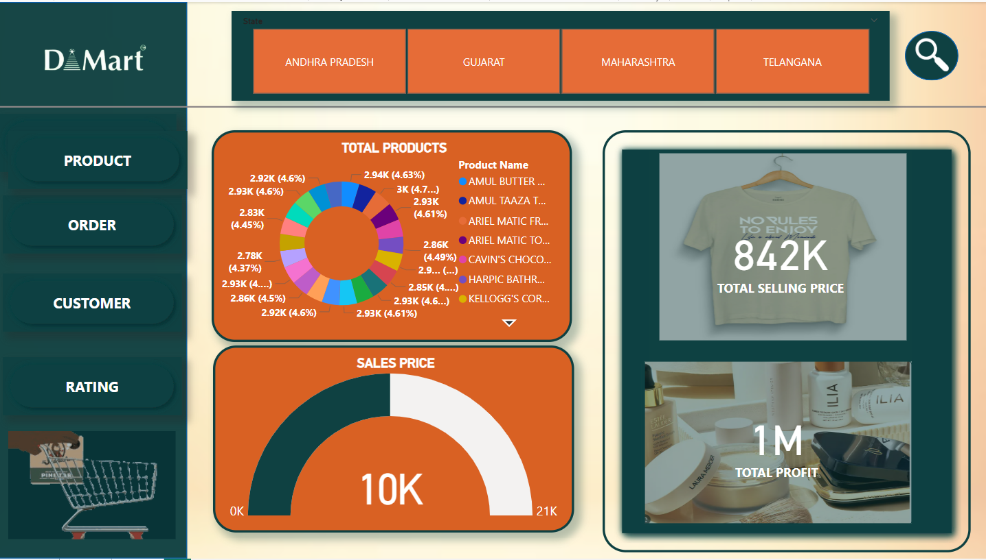
Creating Visuals
Visualizations Created:
Gauge meter to display total discount price.
Pie chart for order payment based on shipment.
Line graph to track inventory levels over time.
Insights Derived:
Identified peak sales months and popular product categories.
Gained insights into customer demographics and preferences.
Highlighted underperforming inventory items for better stock management.

Slide 7
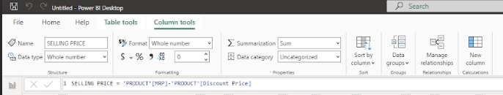
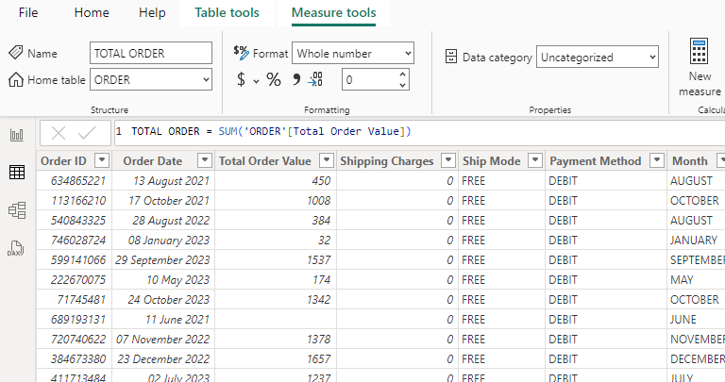
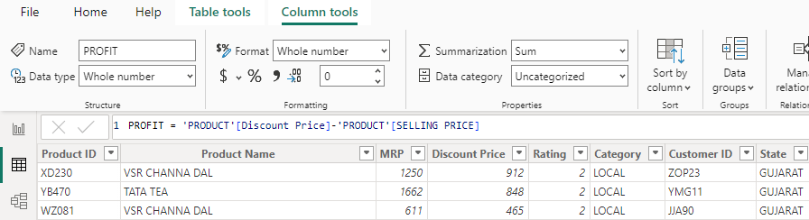
Dax Queries
Calculated Selling Price (SP) as the difference between MRP and Discount Price.
Summed up the Total Profit from the Product table.
Calculated Total Order Value by multiplying the Selling Price with the Total Order quantity.

Slide 8
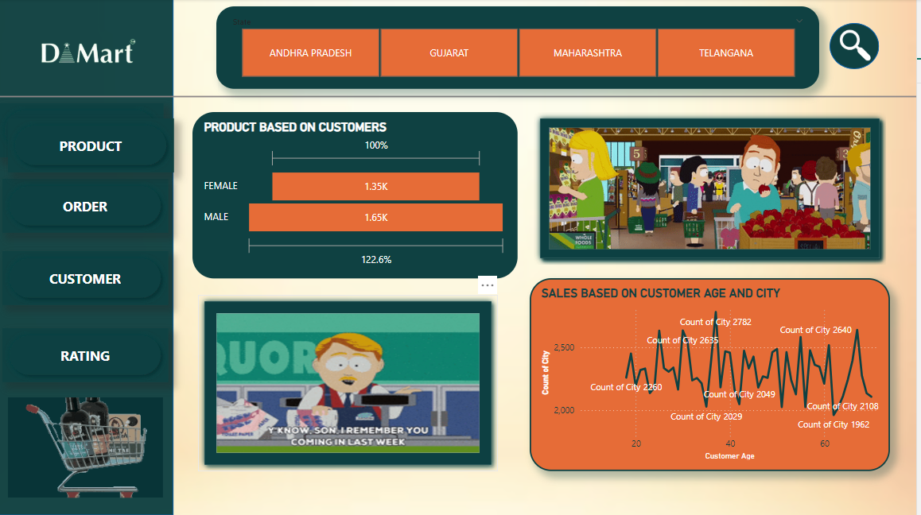
Power Bi Report
Sales Performance: Year-over-year trends, best-selling products, and revenue distribution.
Customer Insights: Regional preferences and purchase behavior.
Operational Metrics: Inventory turnover and shipment efficiency.

Slide 9

Challenges and Learnings
Challenges Faced:
Handling large datasets with inconsistent formatting and missing values.
Establishing relationships between multiple tables with complex structures.
Writing and optimizing DAX queries for accurate calculations and metrics.
Designing visuals to balance aesthetics and clarity.

